Slide 1
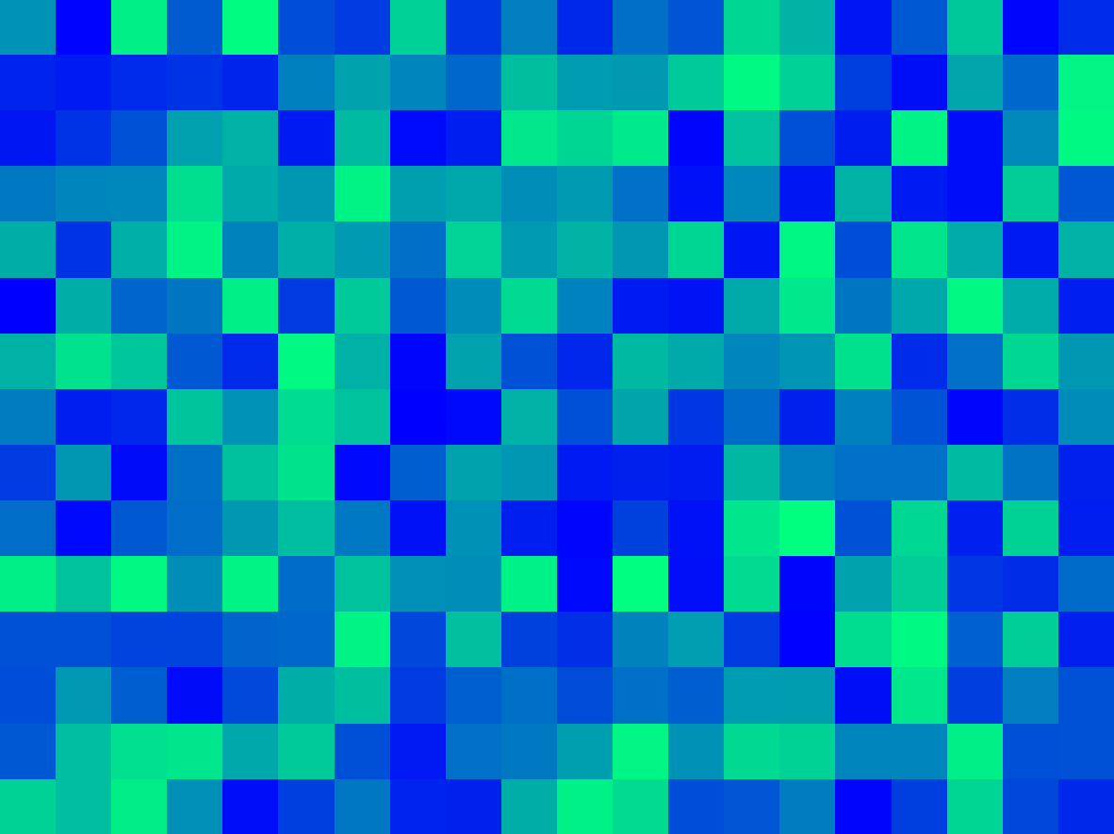
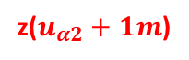
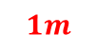
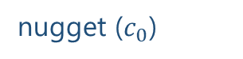
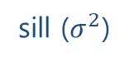
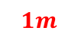
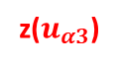
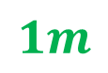
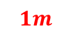
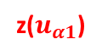
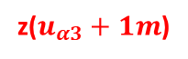
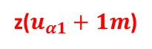

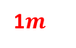
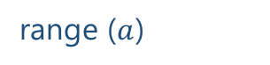

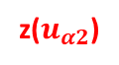
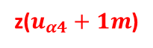
$$1m$$
variance ($γ$)
z($u_{α1}$)
z($u_{α1}+1m$)
sill ($σ^{2}$)
$$1m$$
$$1m$$
1$m$
nugget ($c_{0}$)
z($u_{α4}$)
z($u_{α4}+1m$)
z($u_{α2}$)
z($u_{α2}+1m$)
$$1m$$
range ($a$)
z($u_{α3}$)
z($u_{α3}+1m$)
lag distance (h)

Slide 2

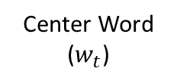
Feature vector
Center Word
($w_{t}$)
man passes sentence should swing sword the who
The
0 0 0 0 0 0 1 0
man
1 0 0 0 0 0 0 0
who
0 0 0 0 0 0 0 1
aegis4048.github.io
sword
0 0 0 0 0 1 0 0

Slide 3
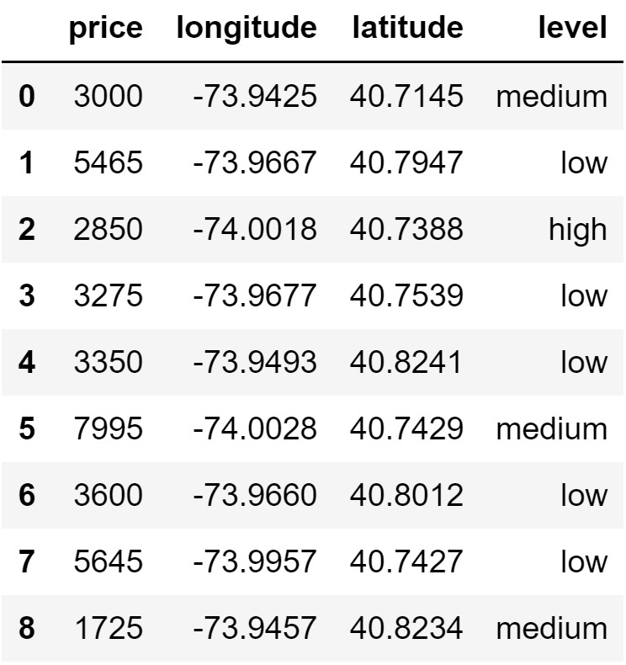
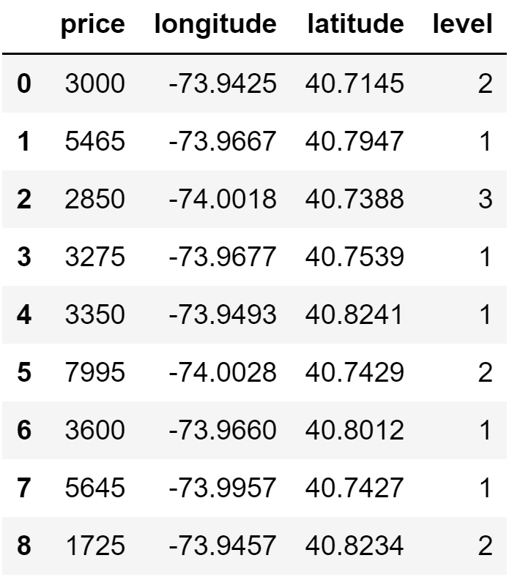
aegis4048.github.io
aegis4048.github.io

Slide 4
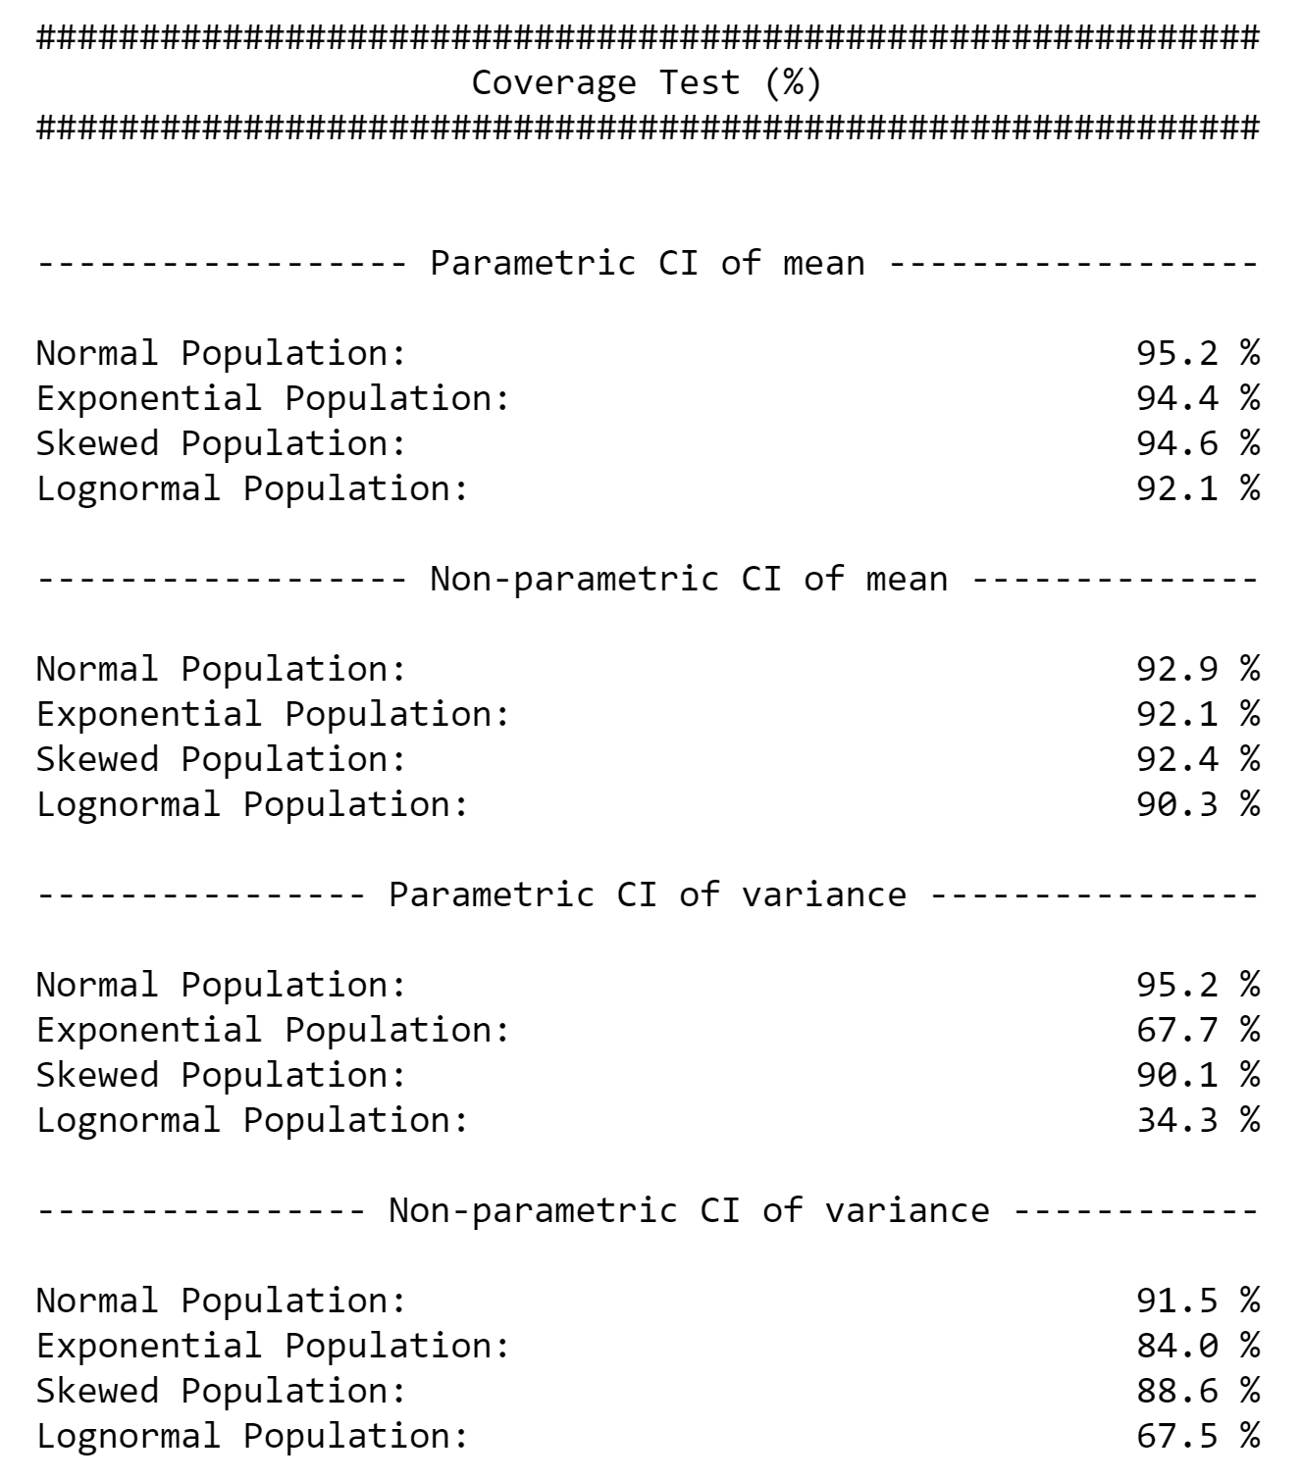
aegis4048.github.io

Slide 5
Direct Sampling
Bootstrap Resampling
VS.
5
7
8
5
12
17
8
11
13
6
4
15
6
2
3
4
10
2
9
14
1
16
Bootstrap population = Original sample
Population
aegis4048.github.io
6
5
5
6
6
5
4
2
4
2
6
8
5
4
8
8
2
8
8
2
5
5
4
4
2
8
6
6
2
Bootstrap
sample (n=5)
Bootstrap
sample (n=5)
Bootstrap
sample (n=5)
Bootstrap
sample (n=5)
Bootstrap
sample (n=5)
4
Mean = 5.2
Mean = 4.2
Mean = 5.2
Mean = 5.0
Mean = 5.4
Original sample
Bootstrap Samples
ANALYSIS
ANALYSIS

Slide 6
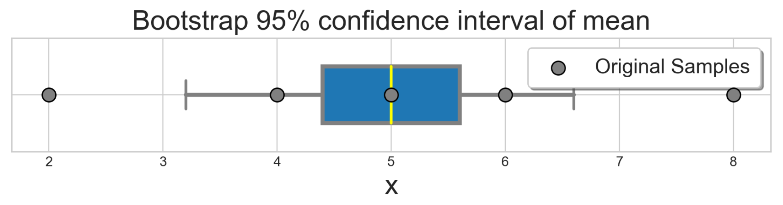


8
5
Original sample (n=5)
6
2
4
Monte-Carlo iteration of bootstrap $r=6$ times
aegis4048.github.io
6
6
6
5
8
5
5
8
4
6
2
4
2
8
6
4
8
8
2
8
5
2
5
4
4
2
8
6
8
2
Bootstrap
sample (n=5)
Bootstrap
sample (n=5)
Bootstrap
sample (n=5)
Bootstrap
sample (n=5)
Bootstrap
sample (n=5)
Bootstrap
sample (n=5)
Mean = 5.2
Mean = 4.2
Mean = 5.2
Mean = 5.0
Mean = 5.4
Mean = 6.4
aegis4048.github.io
$r=6$ bootstrap sample means

Slide 7
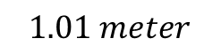
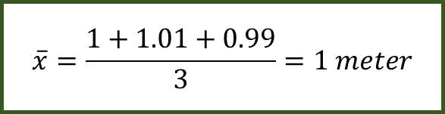
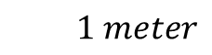
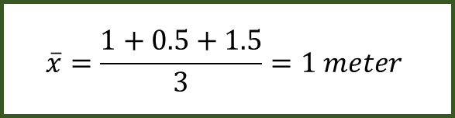
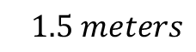
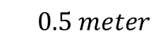
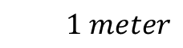
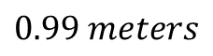
$$1 meter$$
$$\overline{x}=\frac{1+0.5+1.5}{3}=1 meter$$
$$0.5 meter$$
$$1.5 meters$$
aegis4048.github.io
$$1 meter$$
$$\overline{x}=\frac{1+1.01+0.99}{3}=1 meter$$
$$1.01 meter$$
$$0.99 meters$$
aegis4048.github.io

Slide 8
Mode 1
Mode 2
Median 1
Median 2
Mean 1
Mean 2
Overlap of 95% Conf. Int. of Means
aegis4048.github.io

Slide 9
Mean
Median
Fig (a)
Fig (b)
Mode
Mode
Median
Mean
95% Conf. Int. of Mean
95% Conf. Int. of Mean
aegis4048.github.io
aegis4048.github.io

Slide 10
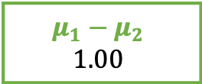
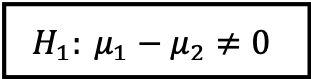
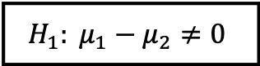
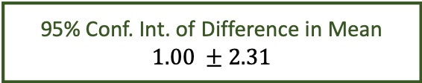
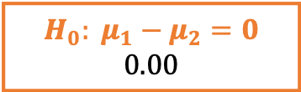
95% chance that difference in mean
falls between -1.31 and 3.31
Lower Limit
Lower Limit
-1.31
3.31
95% Conf. Int. of Difference in Mean
$$1.00 ±2.31$$
$$H_{0}: μ_{1}−μ_{2}=0$$
$$0.00$$
aegis4048.github.io
$$H_{1}: μ_{1}−μ_{2}≠0$$
$$H_{1}: μ_{1}−μ_{2}≠0$$
$$μ_{1}−μ_{2}$$
$$1.00$$
2.5%
outliers
2.5%
outliers

Slide 11
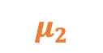
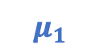


Similar “enough”
“Significantly” different
aegis4048.github.io
aegis4048.github.io
$$μ_{1}$$
$$μ_{2}$$
$$μ_{1}$$
$$μ_{2}$$

Slide 12



























Population
Samples
aegis4048.github.io
sample set 1
aegis4048.github.io
aegis4048.github.io
sample set 2

Slide 13
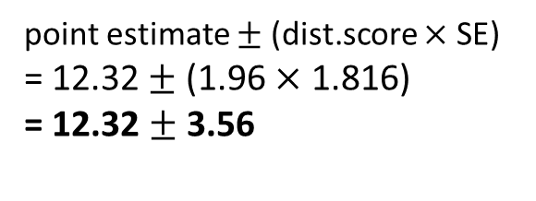
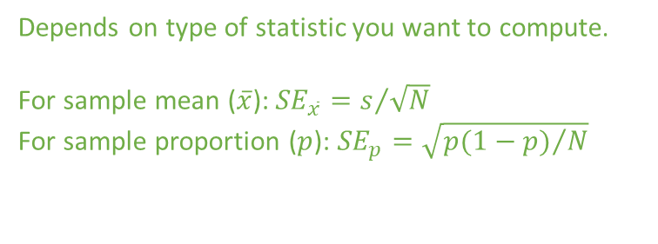
Depends on type of distribution. Tells how many standard deviation away is the limit from the center
point estimate $±$ (dist.score $×$ SE)
= 12.32 $±$ (1.96 $×$ 1.816)
= 12.32 $±$ 3.56
Depends on type of statistic you want to compute.
For sample mean ($\overline{x}$): ${SE}_{\overline{x}}=s/{\sqrt{N}}$
For sample proportion ($p$): ${SE}_{p}=\sqrt{{p(1−p)}/N}$

Slide 14
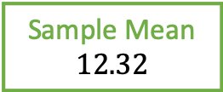
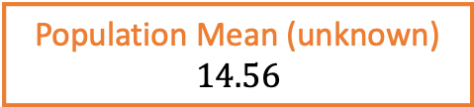
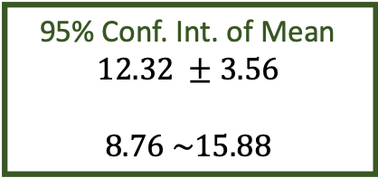
Distribution of Population
falls between 4.70 and 24.42
Lower Limit
Lower Limit
4.70
24.42
95% Conf. Int. of Mean
$$12.32 ±3.56$$
$$8.76 \sim 15.88$$
Population Mean (unknown)
$$14.56$$
Sample Mean
$$12.32$$
aegis4048.github.io

Slide 15
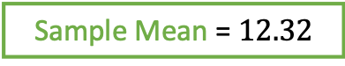
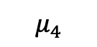


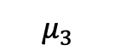
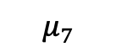

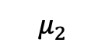
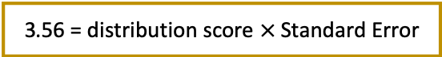
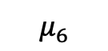
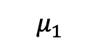

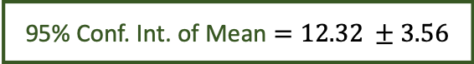

Lower Limit
95% chance that population mean
falls between 8.76 and 15.88
Upper Limit
8.76
15.88
95% Conf. Int. of Mean $=12.32 ±3.56$
$$−3.56$$
$$+3.56$$
$$−(dist.score×SE)$$
$$+(dist.score×SE)$$
aegis4048.github.io
3.56 = distribution score $×$ Standard Error
2.5%
outliers
2.5%
outliers
Sample Mean = $12.32$
$$μ_{1}$$
$$μ_{2}$$
5% chance
$$μ_{3}$$
$$μ_{4}$$
$$μ_{5}$$
$$μ_{6}$$
$$μ_{7}$$

Slide 16


100% chance that your clip length
falls between 2cm and 3cm
2.?? cm
depends on tick mark spacing
1
2
3
4
5
6
7
8
point estimate $±$ measurement E.
2.5 $±$ 0.5 cm
cm
aegis4048.github.io

Slide 17

aegis4048.github.io
aegis4048.github.io

Slide 18


Slide 19

aegis4048.github.io
aegis4048.github.io

Slide 20

aegis4048.github.io
aegis4048.github.io

Slide 21

aegis4048.github.io
aegis4048.github.io

Slide 22

aegis4048.github.io
aegis4048.github.io

Slide 23

aegis4048.github.io
aegis4048.github.io

Slide 24

aegis4048.github.io
aegis4048.github.io

Slide 25

aegis4048.github.io
aegis4048.github.io

Slide 26

aegis4048.github.io
aegis4048.github.io

Slide 27

aegis4048.github.io
aegis4048.github.io

Slide 28

aegis4048.github.io
aegis4048.github.io

Slide 29

aegis4048.github.io

Slide 30

aegis4048.github.io

Slide 31


Binomial Classification
(regression, logistic)
(regression, zebra)
(regression, machine)
(regression, pimples)
(regression, sigmoid)
VS
(regression, Gangnam-Style)
(regression, supervised)
(regression, toothpaste)
aegis4048.github.io
(regression, neural)
(regression, idiot)
Likely to observe
$$p(D=1|w,c_{pos})≈1$$
Unlikely to observe
$$p(D=1|w,c_{neg})≈0$$

Slide 32



True: $σ\left(x\right)$ > 0.5
False: $σ\left(x\right)$ < 0.5
aegis4048.github.io

Slide 33

aegis4048.github.io
aegis4048.github.io

Slide 34










Center word: drilling
$$K=5$$
$$iter=1$$
$$iter=2$$
$$iter=3$$
$$iter=4$$
Current context word: engineer
$$p\left(D=1 | w_{drilling},c_{engineer}\right)$$
$$p(D=1|w_{drilling},c_{minimized})$$
$$p(D=1|w_{drilling},c_{primary})$$
$$p(D=1|w_{drilling},c_{concerns})$$
$$p(D=1|w_{drilling},c_{led})$$
$$p\left(D=1 | w_{drilling},c_{page}\right)$$
0.432
0.312
0.565
0.102
0.853
0.642
0.653
0.169
0.221
0.043
0.532
0.380
0.853
0.042
0.083
0.009
0.115
0.101
0.998
0.000
0.001
0.000
0.001
0.002
engineer
minimized
Update $θ$
Update $θ$
Update $θ$
primary
$$=$$
concerns
led
aegis4048.github.io
aegis4048.github.io
aegis4048.github.io
page

Slide 35
Drilling fluids serve to balance formation pressures while drilling to ensure wellbore stability. They also carry cuttings to the surface and cool the bit. The drilling engineer traditionally designs drilling fluids with two primary goals in mind:
To ensure safe, stable boreholes, which is accomplished by operating within an acceptable mud-weight window
To achieve high rates of penetration so that rig time and well cost can be minimized
These primary considerations do not include well productivity concerns. A growing recognition of the importance of drilling-induced formation damage has led to the use of drill-in fluids (fluids used to drill through the pay zone) that minimize formation damage. This page discusses the formation damage that may be associated with various types of drilling fluids.
current context word
aegis4048.github.io
aegis4048.github.io

Slide 36

Vanilla Skip-Gram
aegis4048.github.io
aegis4048.github.io
Negative Sampling
aegis4048.github.io
aegis4048.github.io

Slide 37




Complexity = $O\left(V+V\right)≈O\left(V\right)$
where $V$ is very large
Computed $V$ times
for all vocabs
aegis4048.github.io
$V$ computations are needed to get normalization factor

Slide 38

aegis4048.github.io

Slide 39

aegis4048.github.io

Slide 40

aegis4048.github.io
aegis4048.github.io
aegis4048.github.io

Slide 41

aegis4048.github.io
aegis4048.github.io
aegis4048.github.io

Slide 42

aegis4048.github.io

Slide 43

aegis4048.github.io
aegis4048.github.io
aegis4048.github.io

Slide 44

aegis4048.github.io
aegis4048.github.io
aegis4048.github.io

Slide 45





$$iter=1$$
$$iter=2$$
$$iter=3$$
$$iter=4$$
0.24
0.42
0.20
0.12
-0.74
-0.82
0.18
0.30
0.12
0.09
-0.32
-0.46
0.08
0.12
0.04
0.02
-0.12
-0.13
0.01
0.02
0.01
0.00
-0.01
-0.02
man
$$\sum_{c=1}^{C}{e_{c}}=$$
passes
Update $θ$
Update $θ$
Update $θ$
sentence
should
aegis4048.github.io
aegis4048.github.io
the
who

Slide 46





$$c=1$$
$$c=2$$
0.12
0.21
0.10
0.06
-0.87
0.09
0.12
0.21
0.10
0.06
0.13
-0.91
0.24
0.42
0.20
0.12
-0.74
-0.82
man
passes
$$\sum_{c=1}^{C}{e_{c}}=$$
sentence
$$+$$
$$=$$
should
aegis4048.github.io
the
who

Slide 47






$$y_{true}$$
($V$-dim)
$$y_{pred}−y_{true}$$
($V$-dim)
0
0
0
0
1
0
0.12
0.21
0.10
0.06
-0.87
0.09
man
$$y_{pred}$$
($V$-dim)
passes
sentence
$$=$$
should
0.12
0.21
0.10
0.06
0.13
0.09
$$−$$
c = 1
the
who
aegis4048.github.io
0
0
0
0
0
1
0.12
0.21
0.10
0.06
0.13
-0.91
man
$$−$$
passes
sentence
$$=$$
should
c = 2
the
who

Slide 48
Dimension 3
0.11
0.34
0.54
Achieve
Achieve
Success
aegis4048.github.io
aegis4048.github.io
0.51
0.91
0.65
Success
Dimension 1
Vector distance
Dimension 2

Slide 49
Training Samples
Source Text
The
man
who
passes
the
sentence
should
swing
the
sword.
(passes, who)
(passes, the)

Slide 50
Dimension 3
should
passes
0.1 0.2 0.7
passes
aegis4048.github.io
should
-2 0.2 0.8
aegis4048.github.io
Dimension 1
Dimension 2

Slide 51





Makes it positive
$$W_{output}∙h$$
Softmax ($W_{output}∙h$)
$$y_{pred}$$
-1.23
0.33
0.18
-5.12
-8.79
-2.01
2.56
4.31
0.12
0.08
0.02
0.13
0.23
0.15
0.11
0.16
$$p\left(y_{i}\right)=\frac{e^{y_{i}^{}}}{\sum_{j}{e^{y_{j}}}}$$
aegis4048.github.io
Normalizes to range [0, 1]
Sum($y_{pred})$ = 1

Slide 52

$$W_{input}$$
($V×N$)
man
2 0.5 4
0.1 0.2 0.7
0.3 -2 0.2
-2 0.2 0.8
1 0.7 3
3 5 0.2
passes
sentence
should
aegis4048.github.io
the
who

Slide 53




$$y_{true}$$
($V$-dim)
$$y_{pred}−y_{true}$$
($V$-dim)
0
0
0
0
1
0
0.12
0.21
0.10
0.06
-0.87
0.09
man
$$x$$
($V$-dim)
$$W_{input}$$
($V×N$)
$$h$$
($N$-dim)
$$W_{output}^{T}$$
($N×V$)
$$y_{pred}$$
($V$-dim)
passes
sentence
$$=$$
should
man
0
1
0
0
0
0
2 0.5 4
0.1 0.2 0.7
0.3 -2 0.2
-2 0.2 0.8
1 0.7 3
3 5 0.2
0.12
0.21
0.10
0.06
0.13
0.09
$$−$$
c = 1
passes
the
sentence
0.1
0.2
0.7
0.3 0.1 0.4 -0.4
0.1 0.3 -1.1 0.3
0.1 0.2 0.4 0.1
who
should
aegis4048.github.io
aegis4048.github.io
0
0
0
0
0
1
0.12
0.21
0.10
0.06
0.13
-0.91
man
the
$$−$$
passes
who
sentence
$$=$$
should
c = 2
Input Layer one-hot encoded vector
Word-Embedding matrix – a.k.a “Lookup table”
Hidden (Projection)
Layer for center word (passes)
Word-Embedding matrix for context words (the, who)
Softmax Output
Layer of range
[0, 1)
Sum = 1
the
who
Prediction Error – a.k.a function loss

Slide 54





$$x$$
($V$-dim)
$$W_{input}$$
($V×N$)
$$h$$
($N$-dim)
man
0
1
0
0
0
0
2 0.5 4
0.1 0.2 0.7
0.3 -2 0.2
-2 0.2 0.8
1 0.7 3
3 5 0.2
passes
sentence
0.1
0.2
0.7
Projection of word vector for “passes” from the embedding matrix
should
$$×$$
$$=$$
aegis4048.github.io
the
who

Slide 55







Input Layer ($x$)
($V$-dim)
Assuming Stochastic Gradient Descent…
Center Word
($w_{t}$)
v=0
v=1
v=2
v=3
v=4
v=5
v=6
v=7
man passes sentence should swing sword the who
t=0
The
0 0 0 0 0 0 1 0
t=0
$$θ_{new}=θ_{old}−η∙∇_{θ}J_{0}(θ;w^{(0)})$$
t=1
man
1 0 0 0 0 0 0 0
$$θ_{new}=θ_{old}−η∙∇_{θ}J_{1}(θ;w^{(1)})$$
t=2
who
0 0 0 0 0 0 0 1
$$θ_{new}=θ_{old}−η∙∇_{θ}J_{2}(θ;w^{(2)})$$
aegis4048.github.io
aegis4048.github.io
t=9
sword
0 0 0 0 0 1 0 0
$$θ_{new}=θ_{old}−η∙∇_{θ}J_{9}(θ;w^{(9)})$$

Slide 56



Slide 57

killowatt
electricity
aegis4048.github.io
aegis4048.github.io
Oil Producers
Barrels + bpd

Slide 58

Oil Producers
Barrels + bpd
killowatt
electricity
aegis4048.github.io

Slide 59

electricity
killowatt
Barrels + bpd
Oil Producers
aegis4048.github.io

Slide 60
0
0
0.32
0.79
0
0.05
0.10
0
0
0.91
Achieve
aegis4048.github.io
aegis4048.github.io
0
0
0.34
0.75
0
0.10
0
0
0
0.87
Success

Slide 61
Dimension 3
0.11
0.34
0.54
Achieve
Achieve
Success
aegis4048.github.io
aegis4048.github.io
0.51
0.91
0.65
Success
Dimension 1
Dimension 2

Slide 62

aegis4048.github.io

Slide 63













2$m$
variance ($γ$)
sill ($σ^{2}$)
z($u_{α1}$)
z($u_{α1}+2m$)
2$m$
2$m$
2$m$
z($u_{α4}$)
z($u_{α4}+2m$)
nugget ($c_{0}$)
z($u_{α2}$)
z($u_{α2}+2m$)
2$m$
range ($a$)
range
z($u_{α3}$)
z($u_{α3}+2m$)
lag distance (h)

Slide 64









3$m$
variance ($γ$)
sill ($σ^{2}$)
z($u_{α1}$)
z($u_{α1}+3m$)
3$m$
3$m$
z($u_{α3}$)
z($u_{α3}+3m$)
nugget ($c_{0}$)
range ($a$)
3$m$
range
z($u_{α2}$)
z($u_{α2}+3m$)
lag distance (h)

Slide 65




variance ($γ$)
sill ($σ^{2}$)
nugget ($c_{0}$)
range ($a$)
lag distance (h)

Slide 66


z($u_{α}$)
h
z($u_{α}+h$)

Slide 67








h
z($u_{α1}$)
z($u_{α1}+h$)
h
h
z($u_{α2}$)
z($u_{α2}+h$)
z($u_{α1}$)
z($u_{α}+h$)
h
z($u_{α3}$)
z($u_{α3}+h$)

Slide 69
Y axis (North)
Lag Tolerance
Lag 3
Azimuth
Lag 2
Bandwidth
Lag 1
Azimuth Tolerance
X axis (East)

Slide 70

Z axis (vertical)
Horizontal Major
Horizontal Major
Azimuth
Horizontal Minor
Horizontal Minor
Horizontal Minor
$$θ$$
X axis (East)
Y axis (North)

Slide 71
Y axis (North)
Lag 3
Lag 2
Lag 1
X axis (East)

Slide 72

aegis4048.github.io
aegis4048.github.io
aegis4048.github.io
aegis4048.github.io

Slide 73

aegis4048.github.io

Slide 74

aegis4048.github.io

Slide 75

aegis4048.github.io

Slide 76

aegis4048.github.io

Slide 77

aegis4048.github.io
aegis4048.github.io

Slide 78

aegis4048.github.io

Slide 79

aegis4048.github.io

Slide 80


